Slide 1

2019
Department
Of Computer
Science
&
Electrical And
Electronics
Engineering
MATH-IV
KAS -402
2020-2021
Dr.Rupa Sharma
Associate Professor
vsrsrsys@gmail.com

Slide 2

PART -5

Slide 3
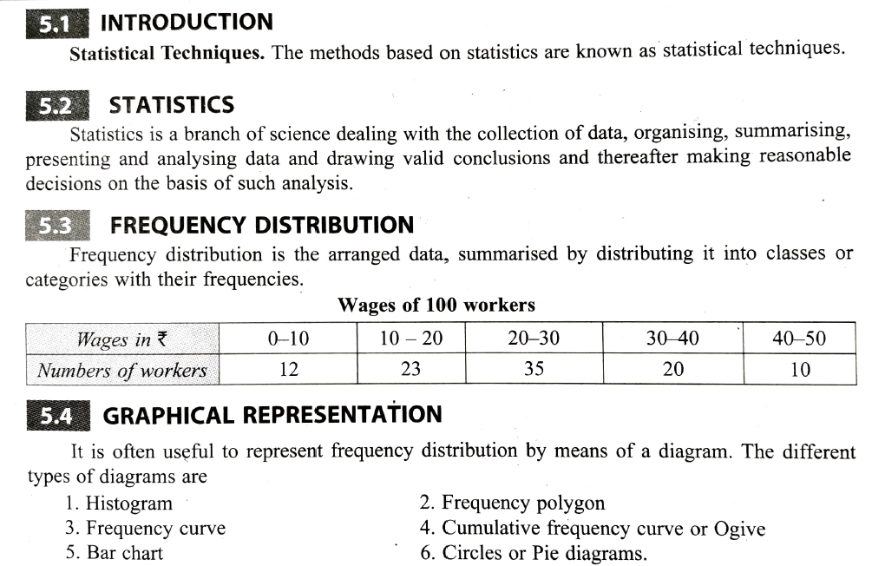

Slide 4
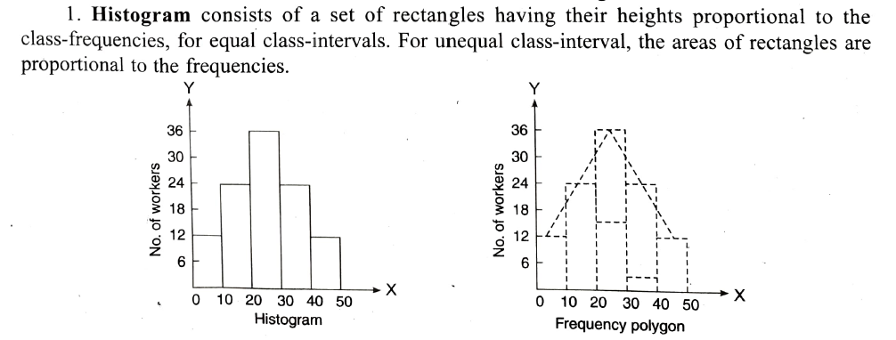

Slide 5
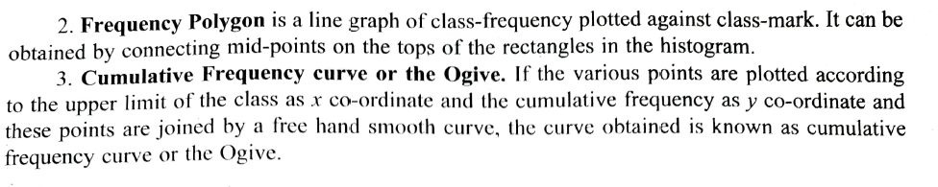

Slide 6
THANK YOU

